Slide 1
Designing and Architecting FHIR Solutions
Lloyd McKenzie
March 12, 2020

Slide 2

Who am I?
Name: Lloyd McKenzie
Company: Gevity
Background:
One of FHIR’s 3 initial editors
Co-chair FHIR Management Group and FHIR-Infrastructure
HL7 Fellow
Heavily involved in HL7 and healthcare exchange for last 19 years (v2, v3, CDA, etc.)
lmckenzie@gevityinc.com

Slide 3
This presentation
Can be downloaded here:
https://github.com/FHIR/documents/raw/master/presentations/2020-03%20Webinars/Designing%20HL7%20FHIR%20Solutions.pptx
Is licensed for use under the Creative Commons, specifically:
Creative Commons Attribution 3.0 Unported License
(Do with it as you wish, so long as you give credit)

Slide 4
Learning Objectives
You should be able to:
List FHIR’s interoperability paradigms and explain when each should be used
Give examples of where FHIR can fit in the architectural stack
Identify several FHIR architectural considerations and describe how to address them
Explain where and how Profiles fit into an architectural solution

Slide 5
Level Setting
Should be familiar with basics of FHIR – from Introduction to FHIR or equivalent presentation or experience
This presentation won’t drill into the hands on details of messaging, documents, XML or JSON syntax, etc.
Focus will be high level architecture considerations
Questions welcome (and encouraged) at any time

Slide 6
Agenda
Tuesday:
Paradigms & Architecture approaches
Wednesday
FHIR Features & Architecture decisions
Thursday:
Remainder of FHIR Features & Architectural decisions
Profiles & Next steps
(May vary from schedule a little bit based on questions…)

Slide 7
Agenda
Before break:
Paradigms & Architecture approaches
Start on FHIR Features & Architecture decisions
After break:
Remainder of FHIR Features & Architectural decisions
Profiles & Next steps
(May vary from schedule a little bit based on questions…)

Slide 8
What Paradigm?

Slide 9
Paradigms
REST
Messages
Other
Documents
FHIR supports 4 interoperability paradigms
What should you use when?

Slide 10
REST
Simple, out-of-the-box interoperability
Leverage HTTP: GET, POST, etc.
Pre-defined operations
Create, Read, Update, Delete
Also: Read Version, Search (resource/type/server), History (resource/type/server), Capabilities, Patch, Batch & Transaction
Rest

Slide 11
FHIR REST URLs
Template | Description | Example | Operations
[base] | Server URL | http://fhir.com | GET, POST
[base]/[type] | Collection Manager | http://fhir.com/Patient | GET, POST
[base]/[type]/[id] | URL for a resource | http://fhir.com/Patient/23 | GET, PUT, DELETE, PATCH
[base]/[type]/[id]/_history/[vid] | Past version | http://fhir.com/Patient/23/_history/2 | GET
[base]/([type]/([id]/)?)?$[name] | Operation (server action) | http://fhir.com/Patient/23/$everything | GET, POST

Slide 12
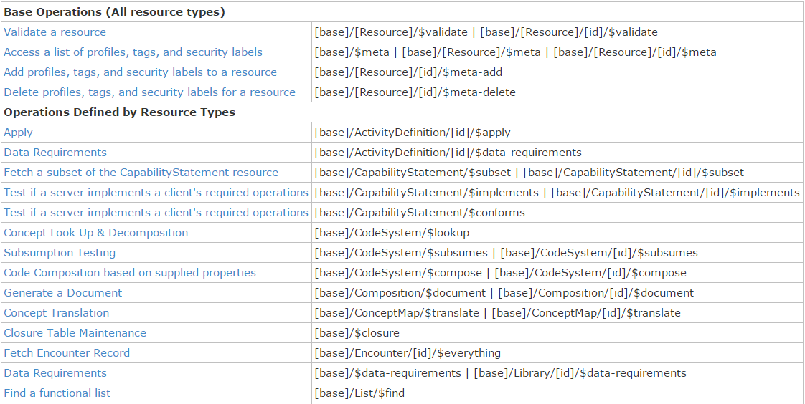
Example operations

Slide 13
When to use REST?
Want low coupling between systems
In theory, very little up-front negotiation required
Small, light-weight exchanges
Focus is CRUD operations
Also for publish/subscribe
Client-driven client-server orchestration
Server endpoint has fixed location
Well-suited for Mobile, PHR, Registries
Rest

Slide 14
When to avoid REST?
Complex or server-driven orchestration
Order of operations matters (e.g. complex decision support)
Unit of work != resource
“Transaction” may be an option
No natural “server” or no fixed network location
Lack of trust in the client for contextual audit, etc.
Rest

Slide 15
Documents
Documents
Similar to CDA
Collection of resources bound together
Root is a “Composition” resource
Just like CDA header
Sent as a Bundle resource
One context
Can be signed, authenticated, etc.

Slide 16
Documents – are bundles
Composition Resource
<Bundle>
<entry>
<resource>
<Composition />
</resource>
</entry>
<entry>
<resource>
<Observation />
</resource>
</entry>
<entry>
<resource>
<Device />
</resource>
</entry>
<entry>
<resource>
<List/>
</resource>
</entry>
<entry>
<resource>
<Condition/>
<resource>
</entry>
</Bundle>
Metadata
Attester
Section
Section
Section
Observation Resource
Device Resource
List Resource
Condition Resource

Slide 17
When to use Documents?
Documents
Focus is on persistence
No workflow involved
other than post/retrieve document
Need tight rules over authenticated content
Want to communicate multiple resources with control over how data is presented
Data spans multiple resources

Slide 18
When avoid Documents?
Documents
Need for workflow
Request/response, decision support
Data is dynamic
I.e. want view of data now, not at time of authorship
Multiple contributors over time
Resources need to be accessed/manipulated independently

Slide 19
Messages
Similar to v2 and v3 messaging
Also a collection of resources as a Bundle resource
Allows request/response behavior with bundles for both request and response
Event-driven
E.g. Send lab order, get back result
Can be asynchronous and/or indirect
Messages

Slide 20
Messages – are bundles
MessageHeader Resource
<Bundle>
<entry>
<resource>
<MessageHeader />
</resource>
</entry>
<entry>
<resource>
<Observation />
</resource>
</entry>
<entry>
<resource>
<Device />
</resource>
</entry>
<entry>
<resource>
<Patient/>
</resource>
</entry>
</Bundle>
source
destination
event
Observation Resource
Device Resource
Patient Resource

Slide 21
When to use Messaging?
Request/response workflow
Need to drive behaviors more complex than CRUD on a single resource
E.g. merge, complex queries
Need for asynchronous/indirect exchange
Need to communicate information about many resources but want to minimize exchanges
No “identity” for many resources
Messages

Slide 22
When to avoid Messaging?
Precise control required on how data gets persisted/displayed to humans
Need for lightweight communications
Want to avoid pre-negotiations on behavior
Messages

Slide 23
Other
FHIR can be used for interoperability in other ways too
Payload in SOAP messages
Persistence model for shared database interface
Shared object model
…
Only requirement is that data complies with one of the FHIR syntaxes and the FHIR semantics
Other

Slide 24
When to use other paradigms?
Use a custom paradigm when capabilities of other paradigms don’t fit requirement
Need for a different form of interface technology
Operations other than CRUD on a resource (e.g. decision support)
Workflow more complex than simple request/response
Need to mix document persistence with behavior
Other

Slide 25
When not to use ‘other’?
When something else will do the job as well
i.e. Don’t define a custom service for something that already naturally is handled by REST, messaging, etc.
Other

Slide 26
Paradigm guidance
No absolutes
Consider a “when to avoid” as a note of caution
Capabilities/architecture of legacy will often drive approach, particularly initially
E.g. If v2 back end, messaging
Architectures will be driven by legacy requirements, architectural preferences, enterprise architecture commitments, etc.

Slide 27
Combining paradigms
No requirement for a system to only support one paradigm
E.g. hospital may be primarily messaging, but use documents for discharge summaries and reports and expose registries and appointments via REST with a few custom services for decision support or specialized workflow
Data (generally) shared easily across paradigm boundaries

Slide 28
Caveats with combining paradigms
If updates come in via document, message or service, RESTful version id still needs to increment
Documents should typically be persisted whole, not reconstituted from parts
Ensures signature validity
Legacy messaging systems may not provide the metadata to easily expose or manipulate discrete resources via REST

Slide 29
Apply it
What paradigm(s) are you like to use in your organization and why?

Slide 30
Learning Objectives
You should be able to:
List FHIR’s interoperability paradigms and explain when each should be used
Give examples of where FHIR can fit in the architectural stack
Identify several FHIR architectural considerations and describe how to address them
Explain where and how Profiles fit into an architectural solution

Slide 31
FHIR Architecture Approaches

Slide 32
Exchange options
v3
App
v2
FHIR
PHR
FHIR
Broker
Comm.
Interface
FHIR
DB

Slide 33
Repository model
HIS
LIMS
PACS
SystemX
Gateway
FHIR
FHIR
FHIR
FHIR
FHIR
Vendor Neutral Repository

Slide 34
Beyond Exchange
v3
Other
v3
v2
Other
v2
Decision Support
Broker
FHIR
FHIR
Repository
FHIR
X12

Slide 35
Overview of a server
HTTP / REST interface
Encoding/decoding, param validation, syntax validation
Implement service operations as described in spec
Fhir Service
Indexer / Search
Storage

Slide 36
From wire to store
REST interface
JSON/XML
JSON/XML
JSON/XML
FHIR Parser
FHIR Parser
FHIR Parser
Fhir Service
POCO/POJO
POCO/POJO
POCO/POJO
O-R Map
Serialize
Serialize
Storage
NoSql (Xml/Json)
DBMS
DBMS

Slide 37



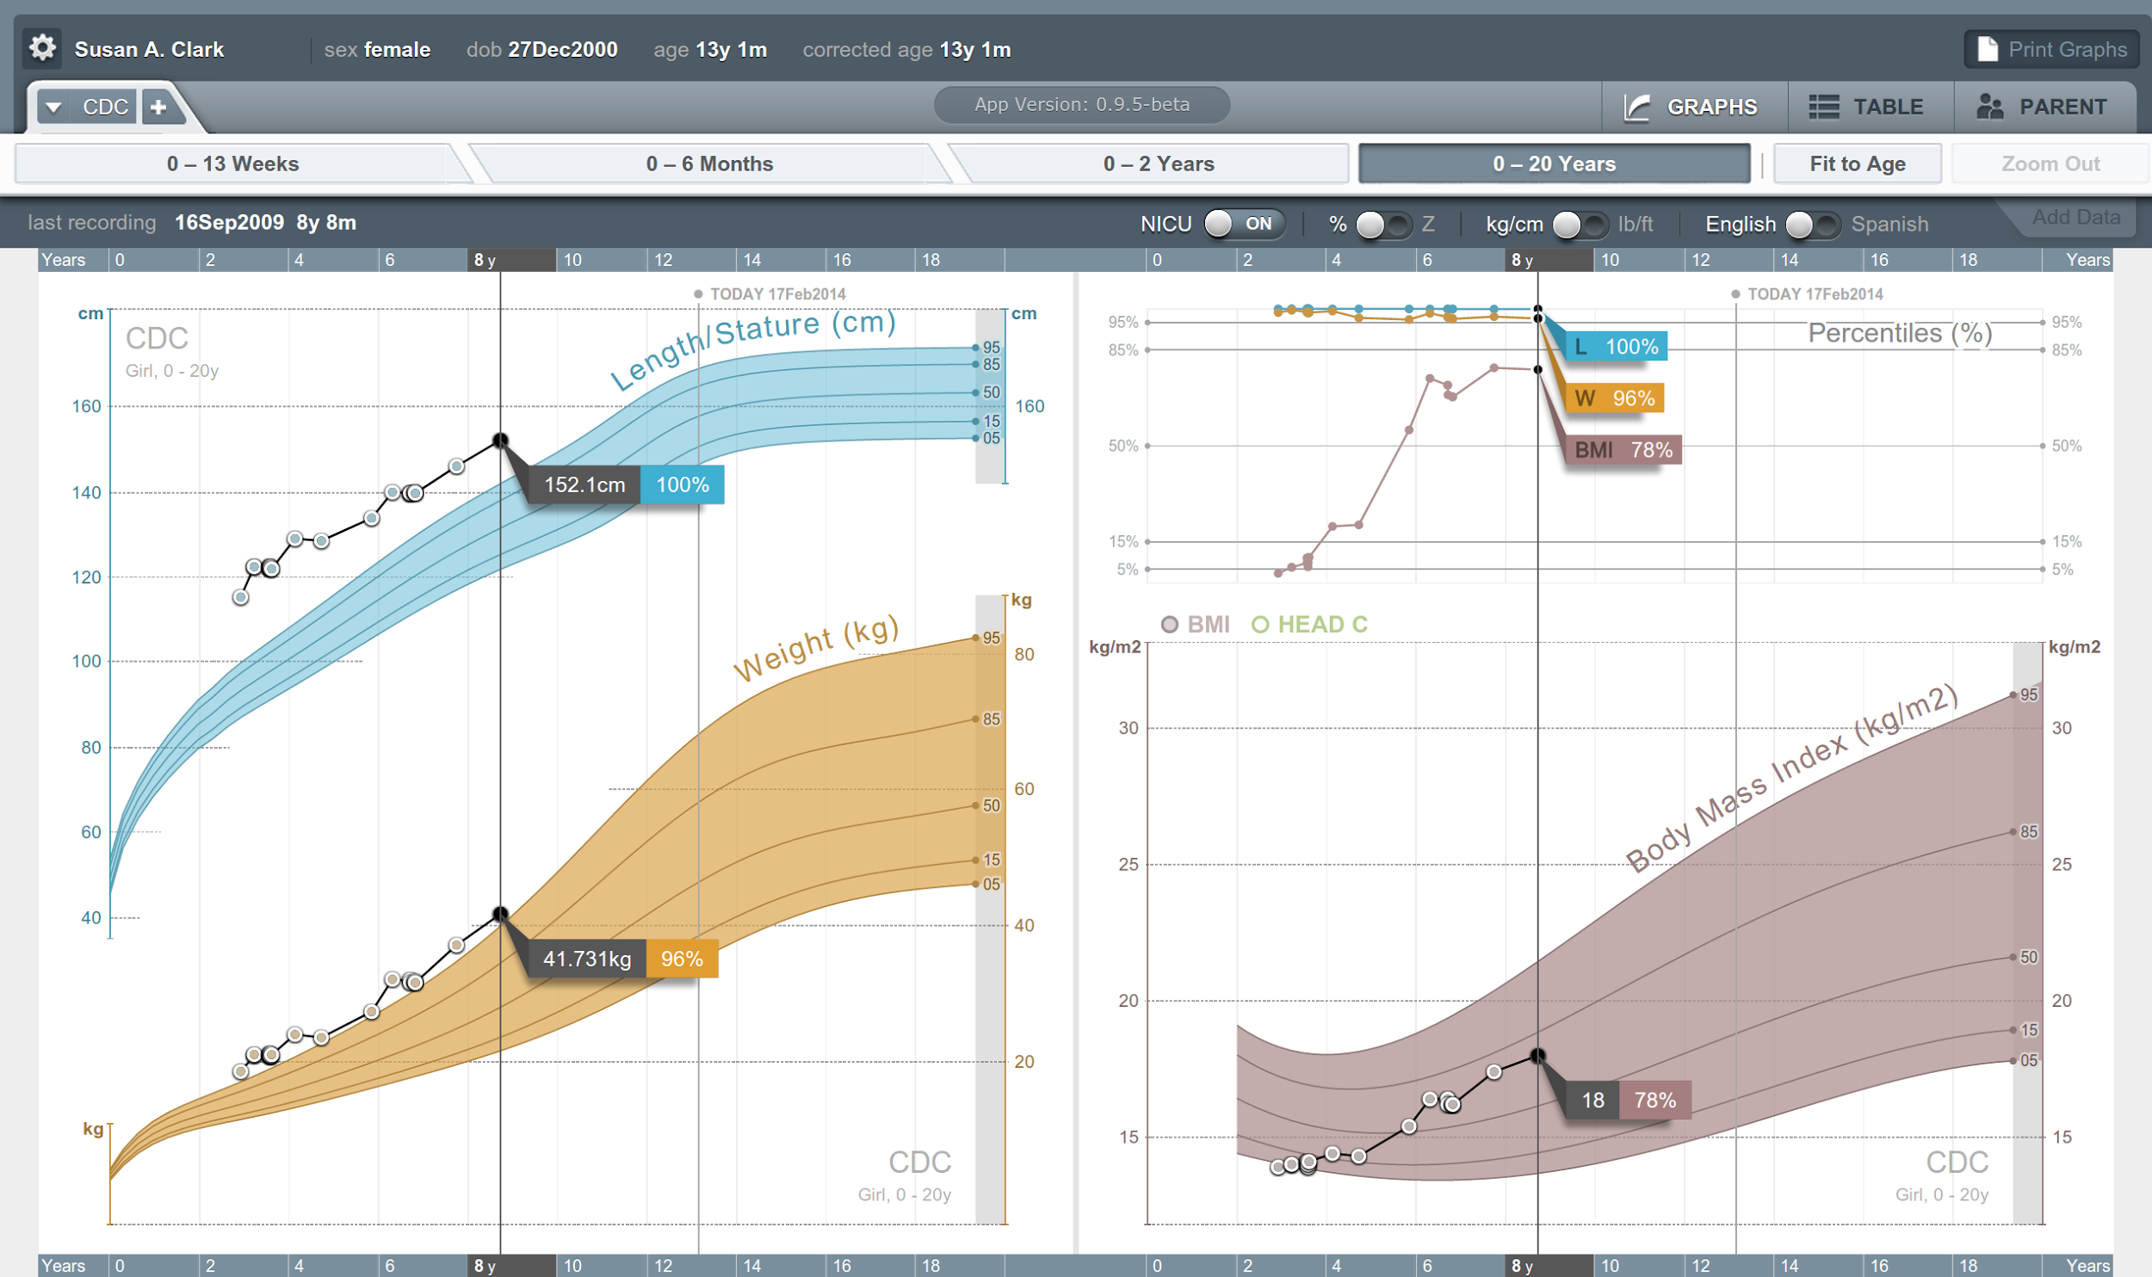


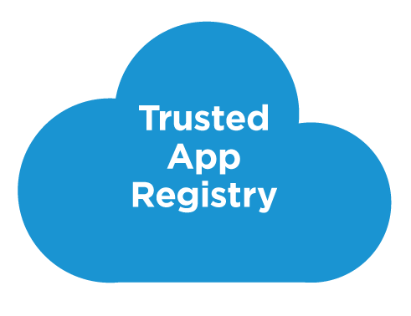



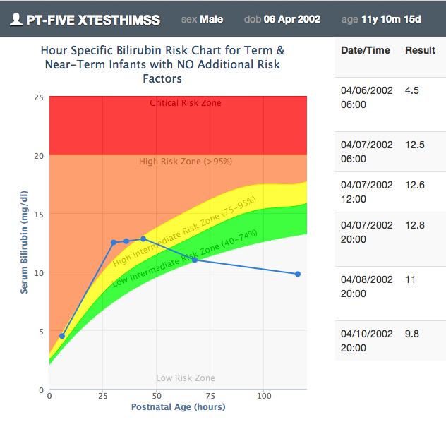







SMART on FHIR
Mobile Apps
Web Apps
OAuth2
REST API
MU-oriented FHIR Data Profiles
Underlying Health IT Systems
Your system here.

Slide 38
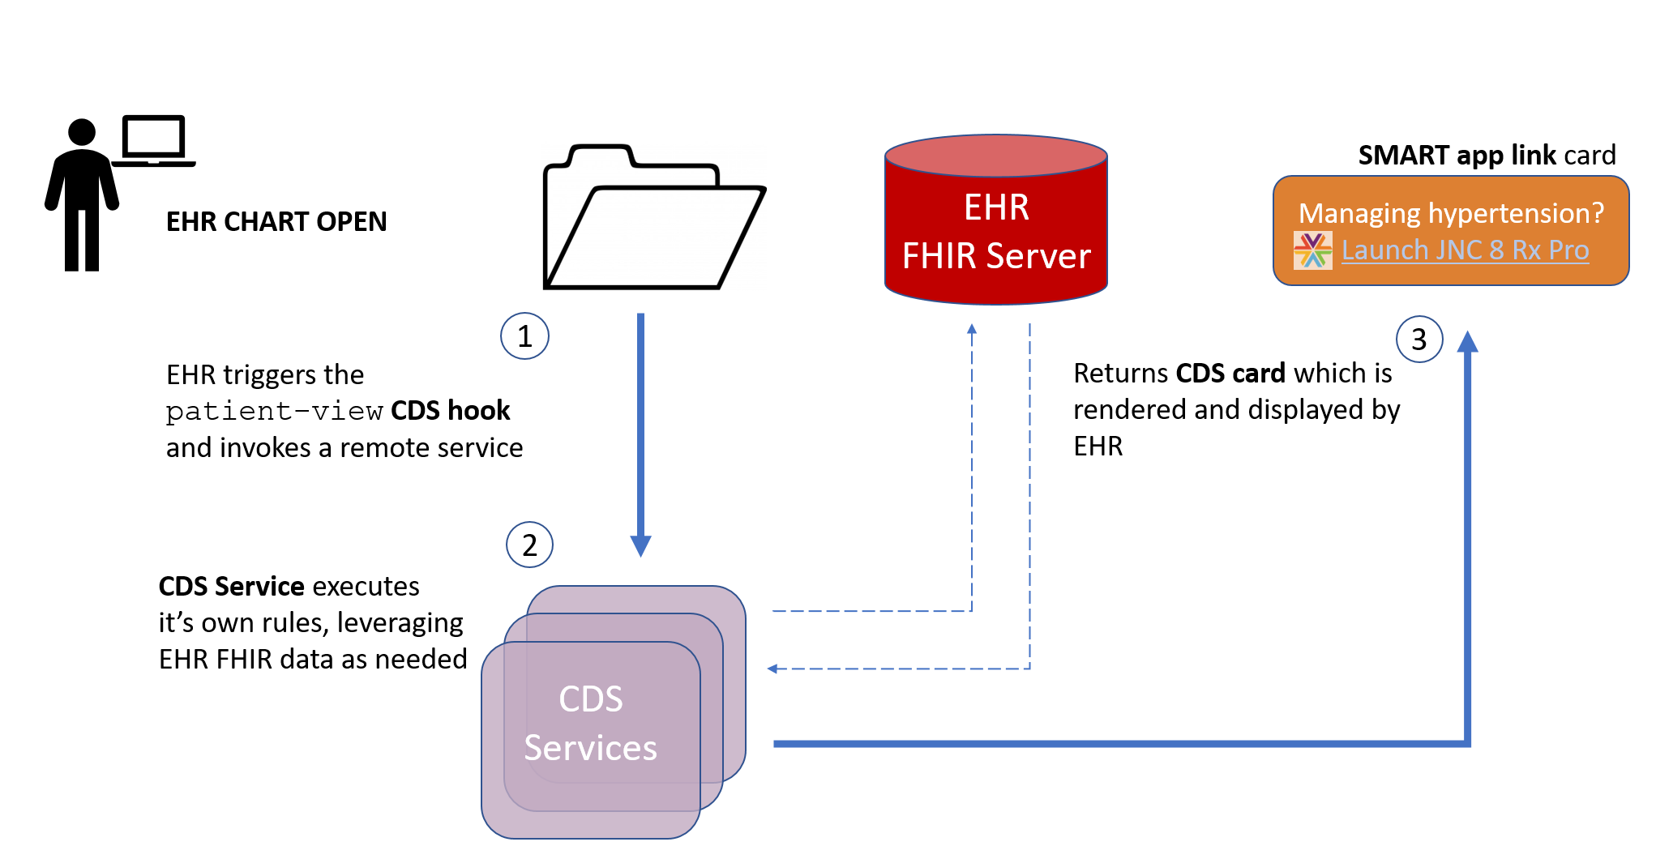
CDS Hooks

Slide 39
Architectures
FHIR makes no assumptions about the architectural design of systems
You can use it for
Light or heavy clients
Central server or peer-to-peer sharing
Push or pull
Query or publish/subscribe
Loosely coupled or tightly coupled environments
With history tracking or without

Slide 40
Bottom Line
FHIR is a set of tools
Defined resources
Extensibility mechanism
Set of standard interfaces
Primary purpose is interoperable data exchange
However, it can be leveraged in many ways
Many we haven’t even thought of yet . . .

Slide 41
Learning Objectives
You should be able to:
List FHIR’s interoperability paradigms and explain when each should be used
Give examples of where FHIR can fit in the architectural stack
Identify several FHIR architectural considerations and describe how to address them
Explain where and how Profiles fit into an architectural solution

Slide 42
FHIR Features
And the architecture decisions that go with them

Slide 43
FHIR Features
Syntaxes
Signatures
Reference Libraries
Conformance Resources
Bundles
Narrative
Extensions
Modifier Extensions
Versions
Tags

Slide 44
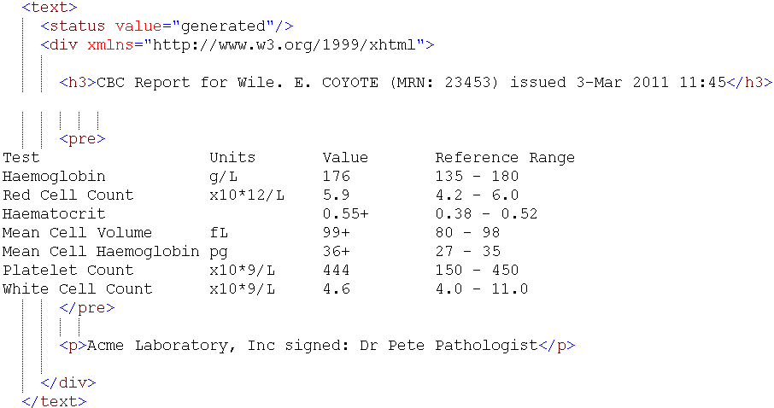
Narrative

Slide 45
Narrative
All resources are expected to have narrative except in narrow circumstances
May be generated or manually edited
Decisions
Should narrative be generated or human-entered?
Generated simplifies processing for receivers
Some text will need to human entered
In some cases, there may be minimal discrete data

Slide 46
Narrative decisions (cont’d)
If generated, which elements should be included? How should they be rendered?
all content needed for a human to understand the essential clinical and business information otherwise encoded within the resource
Will generally include modifierExtensions
May include other extensions
Best to seek clinician and other review of content, order of presentation & rendering
Consider that content may be rendered on mobile devices, so don’t get too fancy with markup

Slide 47
Narrative decisions (cont’d)
Should narrative be displayed to users?
Driven by Narrative.status
Business requirements (e.g. Document attestation) may drive need to render regardless

Slide 48
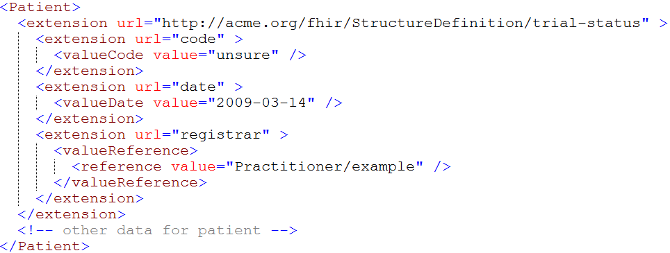
Extensions

Slide 49
Extensions (cont’d)
In FHIR, extensions are “normal”
Consequence of the 80% rule – keep the simple stuff simple
Extensions can exist anywhere
Yes, even inside boolean or date
Systems shouldn’t reject instances just because they contain unrecognized extensions

Slide 50
Extension decisions
Should unrecognized extensions be persisted? How?
Throwing away extensions = loss of potentially useful information to downstream systems
Therefore: Keep extensions if you can
Can capture them in a blob or a generic “slot” structure
Could, with location tagging, capture all “unknown” extensions for a resource in a single blob
Some legacy systems won’t be able to
When data is updated, some extensions must be dropped

Slide 51
Extension decisions (cont’d)
Should you display unrecognized extensions?
Extensions are identified by URL and have a known data type. Can resolve the URL, look up the name and display
Cost/benefit question – some extensions will have little value, others may have a lot
Might want to let users configure what gets displayed
If you do query, look at caching extension definitions to minimize performance issues

Slide 52
Extension decisions (cont’d)
What should you expose as an extension?
If data can be exposed using core structures, it should be
Can still send the same data in an extension
e.g. with more/less granularity, alternate coding, different data type
Look for existing extensions before defining your own
Extensions, if used, should be generic to encourage re-use (and thus broad recognition)
Extension should be on the element described by the extension

Slide 53
Extension decisions (cont’d)
Where to register extensions
Considerations:
What’s the scope? For local extensions, a local registry may make more sense
Is there a need for restricted access?
In general, broad registration = discoverable = broader uptake = broader recognition

Slide 54
Modifier Extensions
Also a core part of FHIR
Needed because some extensions can’t be safely ignored
Can’t compute on an element containing an unrecognized modifier extension. However, can:
Reject instance
Remove element containing unrecognized modifier extension
Just display narrative
Retrieve definition & seek human review

Slide 55
Modifier Extension decisions
When should you introduce them?
modifierExtension breaks interoperability so:
If you can accomplish your objective without one, do that
Consider a new resource or Basic
Could requirement be met by an element that doesn’t change other element interpretations?
Best used when already part of existing practice, but in too narrow an area to justify being part of core

Slide 56
Versions
33, v12 – 2012-12-04
/server.org/fhir/Patient/33/_history/12
33, v13 – 2012-12-05
/server.org/fhir/Patient/33/_history/13
33, v14 – 2012-12-08
/server.org/fhir/Patient/33/_history/14
33, v15 – 2012-12-09
/server.org/fhir/Patient/33/_history/15
/server.org/fhir/Patient/33

Slide 57
Versions (cont’d)
FHIR allows versions to be tracked and retrieved
Do you want to support versioning?
May be difficult or impossible with some legacy data stores
Will still need to have unique version id (UUID, timestamp)
Provides useful collision-detection mechanism

Slide 58
Pop Quiz
Where can extensions appear?
When must a receiver process an extension?

Slide 59
Tags
Patient
MRN 22234
“Ewout Kramer”
30-11-1972
Amsterdam
Tag: system: http://example.org/fhir/Status
code: Test
Profile: http://hl7.org/fhir/StructureDefinition/us-core

Slide 60
Tags (cont’d)
Allow data to be attached to a resource “outside” the resource
Doesn’t break signature when added/changed
3 types:
Security
Profile
General (workflow, etc.)
Require business agreement
Can’t search by tag if authors don’t include them
And populate the same way . . .

Slide 61
Tag decisions
Tag vs. extension?
Use extension if:
Element is associated with the business object rather than electronic record
Part of attested content of resource
Should be included in narrative
Change should force new version

Slide 62
Syntaxes
JSON
{ “B”: { “a” : “c” },
“C”: [ “One”, “Two” ],
“D” : [ “One” ],
“div” : {
“text-before”:“Not ”,
“b”:“so”,
“text-after”:“easy”}
}
XML
<XXX xmlns=“urn:foo”>
<B a=“c” />
<C>One</C>
<C>Two</C>
<D>One</D>
<div>Not <b>so</b> easy</div>
</XXX>

Slide 63
Syntaxes (cont’d)
Multiple representations
XML, JSON, Turtle (RDF)
Reference implementations support both and conversion between
Maximizes interoperability
Inter-conversion is robust enough for digital signatures if the signatures are based on the canonicalized representation

Slide 64
Syntax decisions
What syntax should be used when?
XML used to be required for servers
Now implementer’s choice
XML provides broader tools
XSLT, schema, XPath
JSON uses less bandwidth, more natural for mobile
Turtle/RDF is niche
ideally, servers support all
maximum interoperability

Slide 65
Signatures
Three ways to digitally sign content
Sign bundle (Message or Document)
Sign resource version using Provenance resource
Limited to data integrity
Extension (for more complete signature)
No requirement to sign content
Signatures are just one mechanism of ensuring data integrity and/or non-repudiation
Signatures only hold when converting between different syntaxes when data is canonicalized

Slide 66
Reference library
Currently 5:
C#, Java, Pascal (Delphi), Javascript, Swift
More to come?
Handle parsing, serialization, validation, etc.
Also open source servers, basic clients

Slide 67
Reference library decisions
Use a reference library vs. build your own?
Same criteria as any other “build vs. reuse”
Build costs more, but more tuned
At minimum, consult reference implementations to ensure you don’t miss nuances of specification
How often to update?
Reference libraries changing frequently
Will need to manage updates, especially given that custom code is likely resting on top

Slide 68
Conformance resources
StructureDefinition, ValueSet, ConceptMap, NamingSystem, CapabilityStatement, etc.
Provide “metadata” for operation of systems
Allow for “dynamic” configuration
E.g. Rather than having hard-coded rules for allowed codes, required elements, look it up in ValueSet or StructureDefinition resource
Can be hosted anywhere
Do you require a local copy for performance reasons? Perhaps synchronized copy via publish subscribe?

Slide 69
Conformance resources (cont’d)
Often arranged in cascading hierarchy
E.g. International value set, national value set, local value set
Need to consider timeframe and mechanism for propagating changes from higher levels in the hierarchy

Slide 70
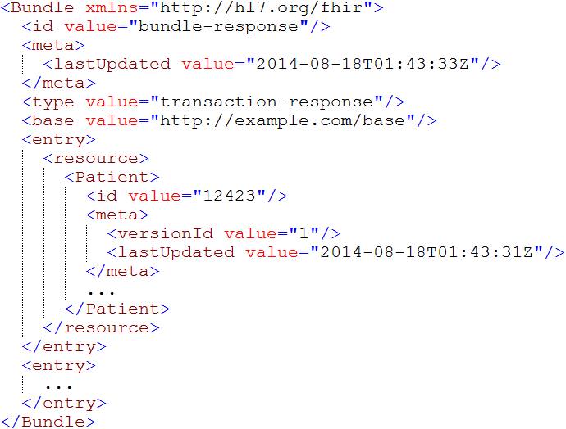
Bundles

Slide 71
Bundles (cont’d)
Mechanism for messages, documents, transactions, query responses
In theory, could regenerate a document from constituent parts, but:
No clear boundary on what’s part of document vs. not
No way to guarantee order of entries
Thus: recommend storing as a binary

Slide 72
Bundle decisions
Ids within a bundle
Resources in bundles can be identified by UUID, RESTful id or version-specific RESTful id
RESTful ids allow information in a document to be linked to existing resource instances outside the bundle.
Version ids should be used if data corresponds to a specific version (as opposed to filtered view)

Slide 73
Bundle decisions (cont’d)
Where’s the resource – bundled, contained, remote?
“contained” should only be used if resource can’t stand alone
Can’t exist if parent is removed
Not enough information to resolve
In bundle for document if part of narrative rendering rules or want part if signed content
In bundle for message if needed to process message and no separate query desired

Slide 74
Apply it
Which of the previous FHIR considerations are you going to pay particular attention to in your implementation?

Slide 75
Additional Considerations

Slide 76
Additional Considerations
Resolving identity
Missing data
Looping
Variable server capabilities
Prohibiting data elements
Interoperating with legacy

Slide 77
Resolving identity
Resource is electronic representation of real-world object
Can have multiple resource instances for same real-world object
Different servers or sometimes even same server
Ids for same resource on different servers can be completely different
Data on different servers can also vary
One resource multiple sites (with different ids)
Available data may vary

Slide 78
Resolving identity (cont’d)
Matching resources within and across servers is generally accomplished by business id (“identifier”)
May also have business “version”
Rules over changing business version are domain-dependent.
Where old versions my be maintained, each version might be distinct instance

Slide 79
Missing data
Extremely few resource or data type elements are required (minOccurs > 0)
Resources and data types are context independent
Extensions might supersede core elements
Therefore
Don’t assume data will be present
Always check for element/@value, not just element
May need to validate to a profile to enforce requirements

Slide 80
Looping
FHIR resources are interrelated in a network, not a hierarchy
Direct and indirect looping relationships are possible
In resource definitions & instances
Even if not possible with core elements, may occur with extensions
Parsing and processing algorithms must deal with this possibility

Slide 81
Variable Server capabilities
FHIR defines a number of mechanisms to give clients control of queries
Paging, many filters, _include, _summary, compartments
However, these are all optional . . .
What should a server do?
Cost/benefit trade-off
More you support, more clients will work with you
Some capabilities may be very expensive in some architectures
Do as much as you can, “within reason”

Slide 82
Variable Server capabilities (cont’d)
What should a client do?
Take advantage of desired capabilities, work with narrow set of servers
Works well in closed environments
Use minimal capabilities, work in most/all environments
Use advanced features where available, fallback to client processing where needed
More efficient but more complex client

Slide 83
Prohibiting data elements
In FHIR, you shouldn’t prohibit unknown extensions or unsupported data elements
You can set a maxOccurs=0 for data elements
This forces clients to customize what they send you – bad practice
Better to accept and ignore
In limited cases, may be liability issues with ignoring data, so rejecting is necessary

Slide 84
Interoperating with legacy
How do you make FHIR play nicely with v2, v3, CDA?
Not enough time to cover here
Look at
http://hl7.org/fhir/comparison.html
The mapping to v2 and CDA streams on http://chat.fhir.org

Slide 85
Learning Objectives
You should be able to:
List FHIR’s interoperability paradigms and explain when each should be used
Give examples of where FHIR can fit in the architectural stack
Identify several FHIR architectural considerations and describe how to address them
Explain where and how Profiles fit into an architectural solution

Slide 86
Profiled FHIR

Slide 87
Profile-less FHIR
You don’t need profiles to interoperate with FHIR
Resources are “discrete” enough that mechanism to populate most elements is clear
Approach
Populate/consume all elements you know, use HL7 or country-standard extensions for extras
Map to/from “recommended” terminologies as much as possible, populate CodeableConcept.text
Expose capabilities in CapabilityStatement resource

Slide 88
Profile Uses
Profiles are still quite useful
Define document and message boundaries
Define extensions
Set interoperability expectations in a particular context
National standards, types of care, business patterns
Clinical practice guidelines / detailed clinical models
Document system capabilities

Slide 89
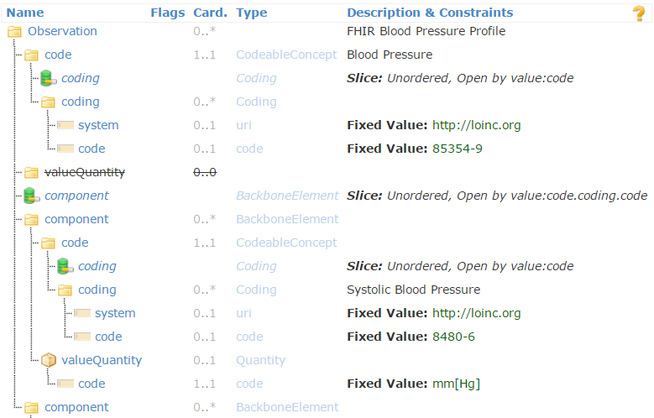
Profiled Observation (Blood Pressure)

Slide 90
Profiles to guide behavior
Profiles can be used to dynamically configure system behavior
Load a profile to guide data entry
E.g. Oncology referral
Load a profile to guide data display

Slide 91
Simultaneous profiles
Multiple profiles can apply to an instance at the same time
Different Codings for different value sets
Include the union of all needed elements
Works best when profiles don’t constrain max occurrences

Slide 92
Declaring profiles
Instances can identify what profiles they support using tags
Considerations:
Is declaration version-specific?
Do you trust the declaration to be accurate?
Will all clients declare the profiles of interest on submissions?
What about profiles of interest defined after data is received?

Slide 93
Learning Objectives
You should be able to:
List FHIR’s interoperability paradigms and explain when each should be used
Give examples of where FHIR can fit in the architectural stack
Identify several FHIR architectural considerations and describe how to address them
Explain where and how Profiles fit into an architectural solution

Slide 94
What Now?

Slide 95
Dealing with STU
FHIR is a “standard for trial use”
Anything can change – no compatibility promised
Changes driven by implementation feedback
Most changes expected in resources
Already significant implementation experience through reference implementations, connectathons
Some needed resources aren’t yet defined
Outbreak, Public Health Case, etc.
Content will continue to go normative over many years

Slide 96
STU Strategies
If multiple STU versions could be in play
Distinguish using mime type (with version) or distinct endpoints
Be prepared to transform between versions to move/rename elements or handle syntax changes
For missing resources
Use Basic
Create your own custom resource
Non-conformant, but ok during STU in closed community

Slide 97
FHIR adoption approaches
Low hanging fruit
Registries
Terminology
MHD (XDS)
CCDA interface
Patient Portals / Mobile Health
Others?

Slide 98
FHIR adoption approaches (cont’d)
Trial & experiment
Green-field
Pilots
“good fit” solutions (mobile, social media)
Elements not standardized elsewhere
Questionnaire, ConceptMap, etc.

Slide 99
FHIR adoption approaches (cont’d)
Deep dive
For the brave
May be premature during STU period, given that specification is likely to change
Ability to adapt to change is essential

Slide 100
FHIR adoption approaches (cont’d)
Monitor
Wait for next release, normative, jurisdictional direction (e.g. meaningful use)
Wait for stability in reference implementations
Wait to see more implementation experience
Ignore
FHIR isn’t relevant to my environment now and is unlikely to ever be

Slide 101

Estimating
How much will implementing a FHIR solution cost?
Considerations
Reference implementations help
Learning curve is lower
Still a curve if unfamiliar with XML / JSON / REST
Faster to “drive by” interoperability
Can’t speed consensus
Tools to help with mapping to internal codes and structures, still takes time
Anecdotal is “faster” to “significantly faster” to implement

Slide 102
Skill requirements
To implement a FHIR solution, you’ll need:
Knowledge of XML and/or JSON
Some degree of familiarity with HTTP (assuming REST)
Likely someone knowledgeable in HTTP security and possibly OAuth

Slide 103
Considerations
What’s giving you pain now?
How could FHIR address those pain points?
What worries you about using FHIR?

Slide 104
Time-points for re-evaluation
Summer 2021?: FHIR R5 published
with key clinical content normative
Additional releases every 18-24 months

Slide 105
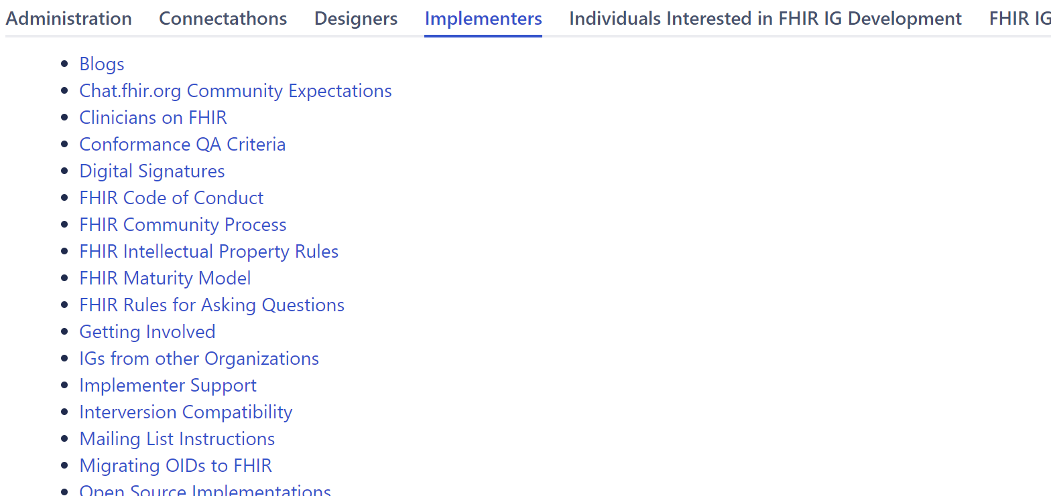
Resources https://confluence.hl7.org/display/FHIR

Slide 106

Next steps for you
Attend other FHIR tutorials
Developers, Profiles, Deep Dive
Read the spec: http://hl7.org/fhir
Join http://chat.fhir.org
Follow #FHIR on Twitter
Shape the specification:
Join the FHIR track at this WGM
Feedback – chat, tracker, list server
Try implementing it
Come to a Connectathon!

Slide 107
Education opportunities
Attend a Working Group Meeting
May 15-22 San Antonio, TX
Sept. 18-25 Baltimore, MD
FHIR Developer Days
Jun. 16-18 Cleveland, OH
Nov. 20-22 Amsterdam
Custom education available

Slide 108

Questions?
http://hl7.org/fhir lmckenzie@gevityinc.com

